Slide 1
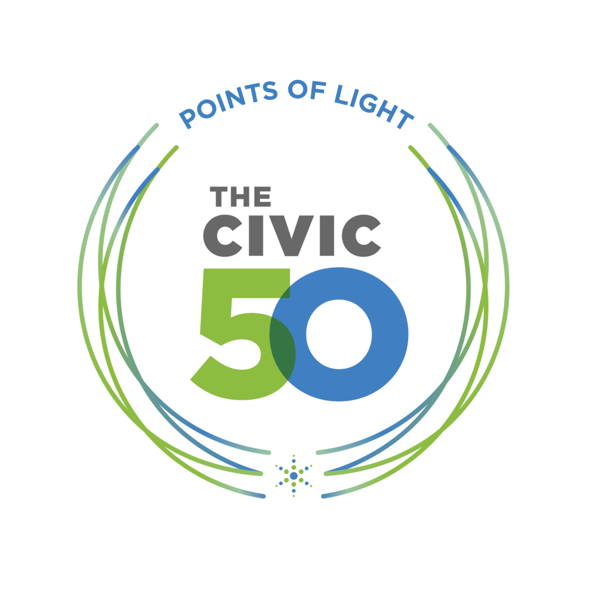






THE CIVIC 50
A ROADMAP FOR SOCIAL IMPACT
INVESTMENT
How strategically your company applies its resources to community engagement, including employee time, skills, cash, in-kind giving, and leadership.
INSTITUTIONALIZATION
How your company supports community engagement through its institutional policies, systems and incentives.
INTEGRATION
How your company’s community engagement program integrates into other business functions and departments.
IMPACT
How your company measures the social and business impact of its community engagement program.
Use The Civic 50 local logo
Questions are multiple choice
and quantitative
Scoring normalized for company
size and annual revenue
Only honoree companies made public
BUSINESS IMPACT
COMMUNITY IMPACT
Notes:
Jenny

Slide 2
REASONS TO PARTICIPATE
THE VALUE FOR COMPANIES
YEAR-ROUND RECOGNITION
In addition to the announcement, honorees are provided with marketing assets and resources to promote their designation internally and externally.
ALIGN & SCALE YOUR PROGRAMS
The Civic 50 framework provides companies with a simple, yet effective tool for aligning and scaling their programs to drive greater community impact.
PEER CONNECTIONS & LEARNING
Connect with and learn from other leading peer companies to share insights and best practices.
SCORECARD REPORT & BENCHMARKING
Every company receives a free scorecard report with benchmarking data to help track annual improvement and communicate your impact story.
STORYTELLING & INSPIRATION
The framework and assessment tool helps companies understand and authentically tell their impact story to inspire others to take action.
STANDARDIZED LANGUAGE
Using the common language and framework accelerates learning and helps advance the sector.
BUSINESS IMPACT
COMMUNITY IMPACT

Slide 3
THE CIVIC 50
STRENGTHEN & SCALE YOUR PROGRAMS
CURRENT YEAR
YEAR 1
YEAR 2+
INVESTMENT
Employee Volunteerism | Cash Contributions | In-kind Contributions | Public Leadership
INTEGRATION
Business Unit | Business Unit | Business Unit | Business Unit
INSTITUTIONALIZATION
IMPACT
COMMUNITY IMPACT METRICS |  | BUSINESS IMPACT METRICS
INVESTMENT
Employee Volunteerism | Cash Contributions | In-kind Contributions | Public Leadership
INTEGRATION
Business Unit | Business Unit | Business Unit | Business Unit
INSTITUTIONALIZATION
IMPACT
COMMUNITY IMPACT METRICS |  | BUSINESS IMPACT METRICS
Element of your social impact or community engagement program

Slide 4
THE CIVIC 50
DATA NEEDED FOR THE ASSESSMENT
Volunteerism
Number of employees participating in external volunteerism
Number of hours employees contributed to external volunteerism and the percent that was skills-based/pro bono
Number of employees participating in internal volunteerism (e.g., employee resource groups, issue education, etc.)
Cash Contributions
Total company financial contributions/grants (excluding employee donations)
Total matching contributions for employee donations
Number of financial contributions/grants (excluding employee matching gifts)
In-Kind Goods
Cost of donated in-kind goods
Market value of donated in-kind goods

Slide 5
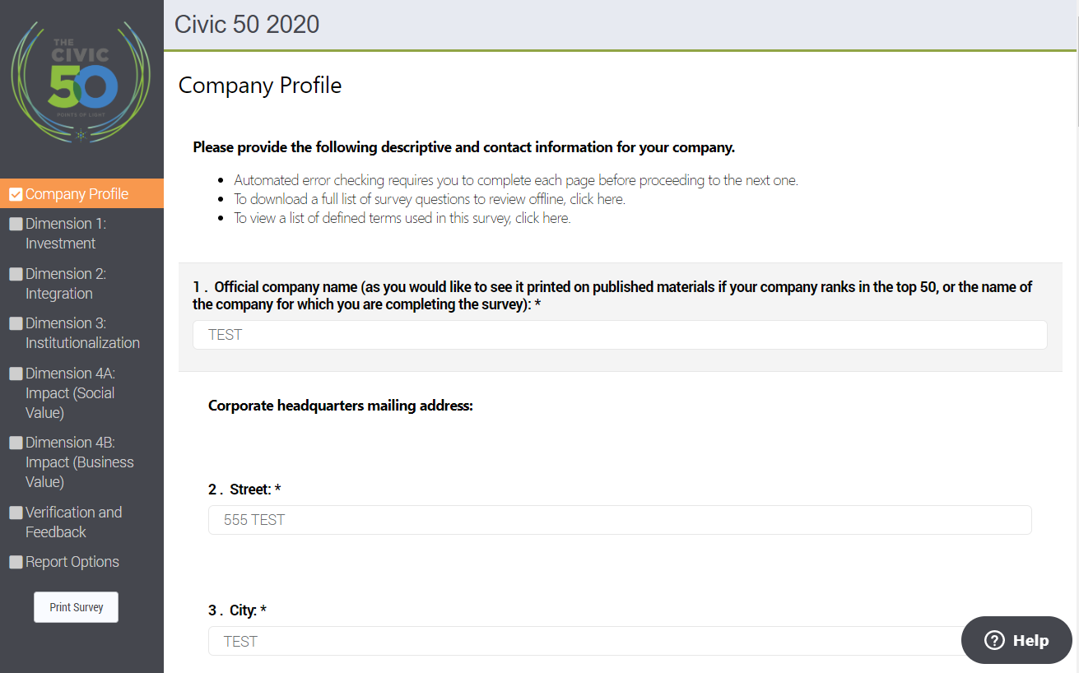
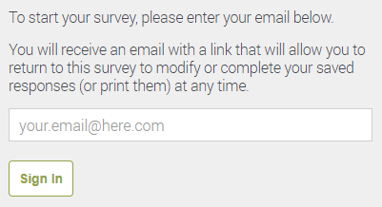

THE CIVIC 50
THE ONLINE ASSESSMENT TOOL
The Civic 50
SURVEY
QUESTIONS
INITIAL
EMAIL
LOGIN
NAVIGATE
BY SURVEY
DIMENSIONS
SAVE & NAVIGATE
Do not use browser back button!
Use emailed link to access and update your survey
TECHNICAL
SUPPORT
PRINT/DOWNLOAD SURVEY RESPONSES

Slide 6
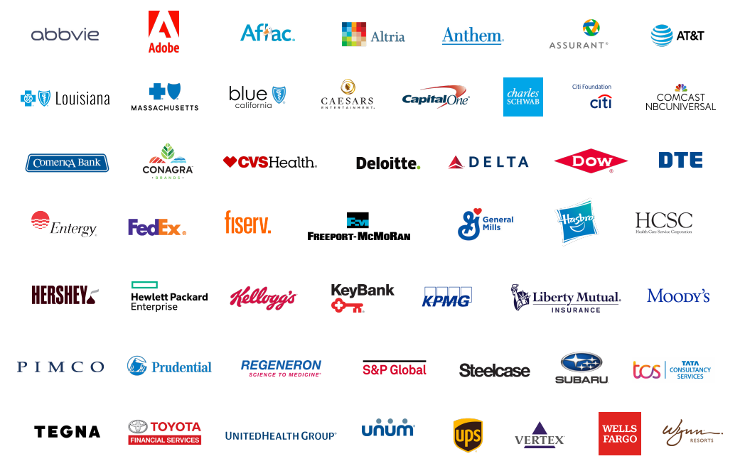
A ROADMAP FOR GOOD CORPORATE CITIZENSHIP
THE CIVIC 50 2021 HONOREES
SECTOR LEADERS
AT&T Inc.
Dow, Inc.
DTE Energy
Hewlett Packard Enterprise
KPMG LLP
Prudential Financial, Inc.
Steelcase
The Hershey Company
UnitedHealth Group
VOLUNTEER LEADER AWARD
Blue Cross and Blue Shield of Louisiana

